Slide 1
SPHL 6000 Fundamentals of Interprofessional Collaboration & Practice
Nichole Valenzuela, MS
Celia Scott Weatherhead School of Public Health & Tropical Medicine
Notes:
Good morning/afternoon I am Nichole Valenzuela, I use she/her/ella pronouns, and I am the Assistant Director for Immersions & Interprofessional Education and the Instructor for SPHL 6000 fundamentals of Interprofessional Collaboration & Practice. The purpose of today’s webinar is to provide you with a thorough overview of the course structure, competencies, assessments, objectives, and more. I ask that you remain muted and hold all questions until the end. Please feel free to write down or put your question in the chat so that you don’t forget it and I will answer them at the end.
Before we get started, I want to assure each of you that there is nothing required of you, as faculty for this IPE course, however there will be opportunities that I will discuss later where you are able to contribute to the overall impact of the IPE program.
To begin let’s talk about the structure of the course. The "Fundamentals of Interprofessional Collaboration & Practice" course (SPHL-6000) is a 1-credit, online, introductory-level course required for all MPH, MSPH, and MPHTM students in their first semester. SPHL 6000 is a full course and will offer 2 sections (online and residential) in the fall and spring semesters. The course will offer live sessions after each competency, which I will explain later. The sessions offered are designed for the student to have the option of attending either the morning or evening session regardless if they are an online or residential student.

Slide 2
Interprofessional Education- 2 phases
Enhances public health outcomes and equips students for effective practice by integrating diverse perspectives and skills. SPHL-6000 equips public health students with the skills and knowledge to effectively collaborate with professionals from other sectors to improve population health outcomes
Students combine perspectives and knowledge of external sectors with their public health training to complete tasks to solve problems.
Notes:
Interprofessional Education is designed to enhance public health outcomes by equipping students for effective practice through the integration of diverse skills and perspectives. This happens in 2 phases. The curriculum provides the skills and knowledge through interactive modules, collaborative discussions, practical activities, and reflections.
In phase 2 the students will then combine the perspectives, skills and knowledge from others with their public health training and use to complete tasks and solve problems in practice settings.

Slide 3
CEPH Foundational Competency #21:
"Integrate perspectives from other sectors and/or professions to promote and advance population health.".
Students are expected to "combine the external sector/profession’s perspective and/or knowledge with their own public health training to complete a task, solve a problem, etc.”
This integration requires active interaction with individuals from other professions or sectors, either in-person or online.
Notes:
As a part of CEPH accreditation our students are expected to “integrate perspectives from other sectors and/or professions to promote and advance population health. To do this effectively, we wanted to first start by providing the knowledge, skills, and values around for Interprofessional Collaboration and Practice so that they could successfully interact and work with individuals from other professions or sectors in person or online with confidence. The IPE course directly addresses this competency through all its learning objectives.

Slide 4
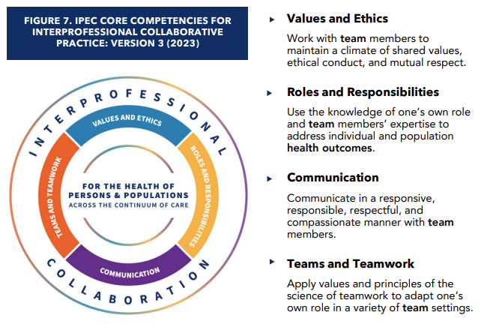
Interprofessional Education Collaborative (IPEC)
The IPEC Core Competencies for Interprofessional Collaborative Practice reflects the vision that interprofessional collaborative practice is key to safe, high-quality, accessible, equitable, person/client-centered care and enhanced population health outcomes desired by all. This competency set is aimed at preparing learners to engage in lifelong learning and collaboration to improve both person/client care and population health outcomes.
Four Core Competencies and 33 sub competencies to broaden their applicability.
Interprofessional Education Collaborative. (2023). IPEC Core Competencies for Interprofessional Collaborative Practice: Version 3. Washington, DC: Interprofessional Education Collaborative.
Notes:
The 4 competency areas used in developing the course come from the Interprofessional Education Collaborative Framework.
The Interprofessional Education Collaborative was formed in 2009 and now represents 21 national health professions associations. Their mission is to ensure that new and current health professionals are proficient in the competencies essential for patient-centered, community- and population-oriented, interprofessional, collaborative practice.
In 2023 they revised the competencies and sub competencies to help frame the national dialogue on the need for IPE (IPE) and collaborative practice (CP) as a catalyst for improving team-based patient care and enhancing population health outcomes.
The four core competencies designed to prepare learners to engage in lifelong learning and collaboration are:
Values and Ethics –(read definition)
Roles and Responsibilities- (read definition)
Communication- (read definition)
Teams and Teamwork (read definition)

Slide 5
SPHL 6000 Learning Objectives
Examine the impact of implicit bias to maintain a climate of shared values, ethical conduct, and mutual respect.
Apply active listening techniques to promote effective communication.
Communicate the roles and responsibilities of a public health professional.
Apply values and principles of the science of teamwork to solve a public health challenge.
Notes:
The learning objectives for SPHL 6000 were selected from the 33 sub competencies under the 4 domains.

Slide 6
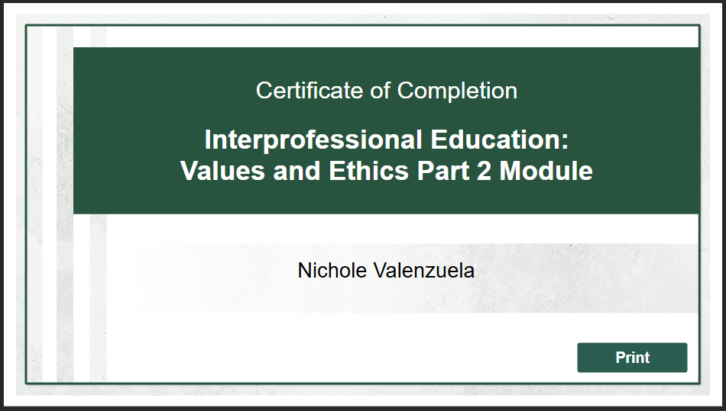
IPE Modules Six Interactive Modules
Introduction to Interprofessional Education
Interprofessional Education: Values and Ethics Part 1
Interprofessional Education: Values and Ethics Part 2
Interprofessional Education: Communication
Interprofessional Education: Roles and Responsibilities
Interprofessional Education: Teams and Team Work
Notes:
Over the course of the semester students will complete six interactive learning modules, asynchronously to address the 4 competencies using the IPEC framework. We will talk about each of these in a moment.
At the end of each completed module students will receive a certificate of completion

Slide 7
Course Assignments Each week, assignments are structured around a specific module that is designed to address one or more of the IPEC Core Competencies.
Modules and competencies are tied directly to course objectives to ensure meaningful application.
For each module, students will complete:
Discussion Post: Engage in collaborative conversations.
Activity: Apply concepts through interactive or practical tasks.
Highlighted Activities: include a public health assessment, resume podcast, team public health challenge and presentation.
Reflection Essay: Analyze and connect learning to professional practice.
Notes:
The course assignments are structured around the specific modules. For each module students will engage in a collaborative conversation, an activity to apply concepts, and a reflection to analyze and connect learning to professional practice.

Slide 8
Introduction to Interprofessional Education
This module introduces interprofessional education (IPE), interprofessional practice (IPP), and intersectoral collaboration.
Learners will communicate the four domains of the Interprofessional Education Collaborative (IPEC Core Competencies for Interprofessional Collaborative Practice) and explain the value and goals of IPE.
Assignment:
Introduction Post & Discussion Board:
What is the purpose and/or benefit of Interprofessional Education?
Notes:
This is the first part of a series of modules introducing interprofessional education. This module introduces interprofessional education (IPE), interprofessional practice (IPP), and intersectoral collaboration. Learners will communicate the four domains of the Interprofessional Education Collaborative (IPEC Core Competencies for Interprofessional Collaborative Practice) and explain the value and goals of IPE.
Students will have an introduction post and discussion around the purpose/and or benefit of Interprofessional Education.

Slide 9
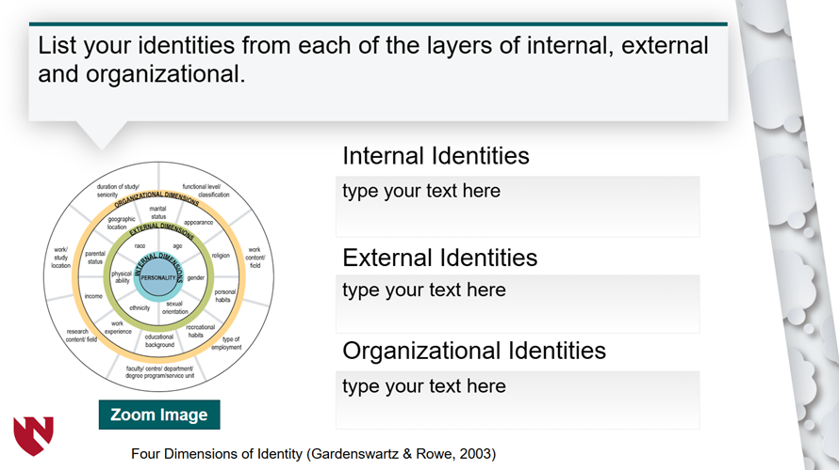
Values & Ethics Part 1
Students will explore key concepts that promote valuing others, fostering trust, and practicing compassion in the workplace. By focusing on building a just culture and a respectful environment, students will learn strategies to support well-being and contribute to a positive, inclusive professional setting.
(bias, cultural competence, cultural humility, ethics & values)
Notes:
The second module is part one of Values and Ethics. There is so much that can be covered within this domain, so we chose to break it up into 2 parts. Part 1 student explore key concepts that promote valuing others, fostering trust and practicing compassion. Students will learn strategies that contribute to inclusive and positive professional settings and support well being. The module covers bias, cultural competence, cultural humility, ethics and values.

Slide 10
Values & Ethics Part 2
This module focuses on ethical decision-making, exploring how personal and professional values influence interprofessional collaboration. Students will also learn tools to mitigate ethical tension in professional environments.
Notes:
Values and Ethics Part 2 focuses on ethical decision-making and how our values shape collaboration. Students will learn tools to navigate ethical tensions in the workplace through a case scenario.

Slide 11
Key Assignment: Implicit Bias Reflection Essay
Students will take two Harvard Implicit Association Tests of their choice. Students will reflect on their own implicit biases.
Students will identify, address, and discuss implicit biases in their work and personal lives.
Students must respond to the required questions and two questions of choice.
Required Questions
• What were your initial thoughts and feelings after taking the implicit bias tests?
• Did you uncover any surprising insights about your own biases that you hadn't considered before?
• What biases or stereotypes do you believe other professions may hold about public health professionals?
In what ways does practicing cultural humility challenge you to reflect on your own perspectives, and how can it strengthen your ability to serve diverse populations
Select Two Questions
• How can becoming aware of implicit biases improve your cultural sensitivity when working with diverse populations?
• What impact might implicit biases have on research design, data collection, and interpretation in public health?
• What strategies can public health professionals use to continuously learn and unlearn biases?
• How can recognizing implicit biases contribute to advancing equity in public health?
Notes:
Following the modules students will take 2 Harvard Implicit Association tests of their choosing. Then they will reflect on their own implicit biases through an essay by answering the 3 required questions and two from the selected choice.
They will also participate in collaborative discussion to talk about How implicit biases influence decision-making and interactions within public health practice and How does adopting a mindset of cultural humility shift the way public health professionals approach community engagement, program design, and policy-making?

Slide 12
Communication
In this module learners will explore the Communication domain of the Interprofessional Education Collaborative.
They will identify effective communication tools and techniques to facilitate discussions and interactions with team members, including active listening.
Notes:
Students will explore communication mediums and identify effective communication strategies and tools to facilitate discussions within a team.

Slide 13
Key Assignment: Active Listening Activity
Students will:
Record and Upload a Video (3–5 minutes):
Engage in a conversation with someone who is explaining how to do something.
Your role is to practice active listening throughout the conversation.
Review and Reflect:
Watch your recorded video and identify the active listening techniques you used.
List each technique and explain how it contributed to effective or ineffective communication during the interaction.
Reflection Prompt:
In your written reflection, respond to the following question: "How does observing your active listening techniques and interactions help improve your overall communication skills, both as a listener and as a communicator?"
Notes:
Students will have the opportunity to practice and observe their own effective communication techniques with this key assignment. They will record and upload a 3-5 minute video of them engaging in a conversation with someone who is explaining a how to. Students will then watch their video, identify techniques used and reflect on how it contributed to effective or ineffective communication. They will then engage in a discussion and respond to the question “How does observing active listening techniques and interactions help improve your overall communication skills as both a listener and as a communicator?

Slide 14
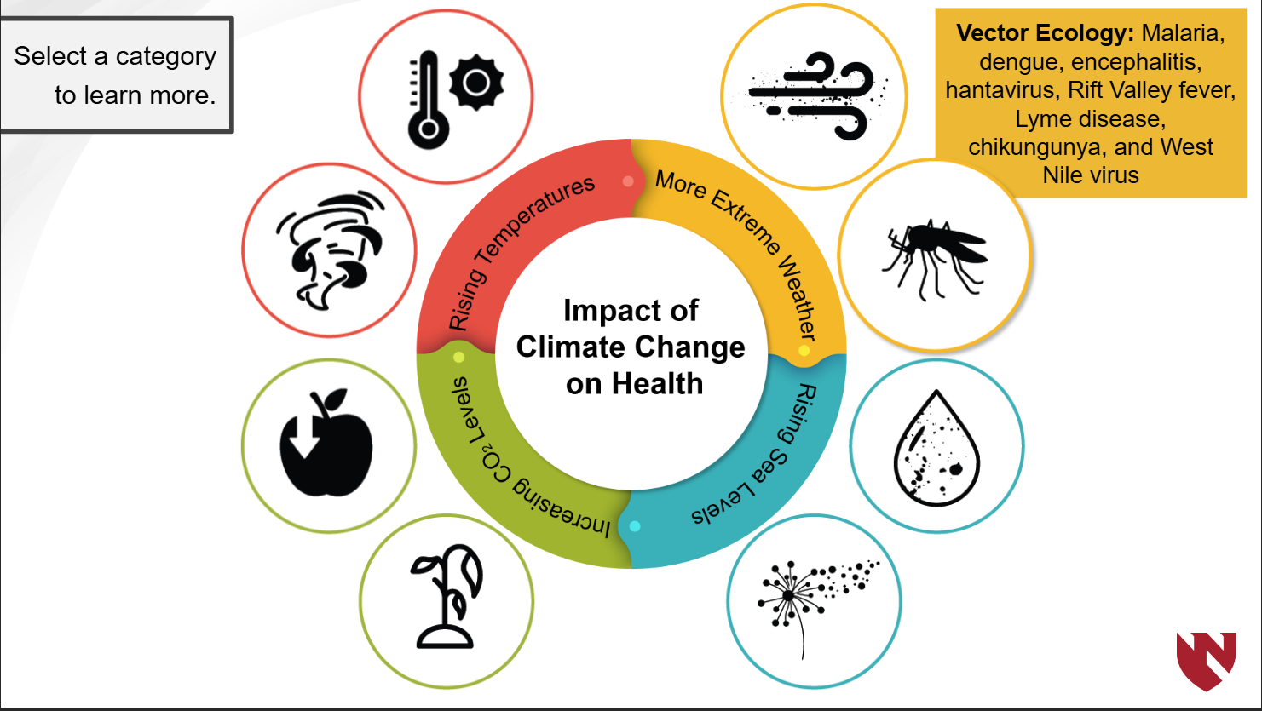
Roles and Responsibilities
This module focuses on fostering an understanding of interprofessional roles and responsibilities, encouraging students to communicate and collaborate effectively.
Students will apply their knowledge of social determinants of health to analyze complex issues and evaluate the impact of different professions on public health outcomes.
Notes:
Students will gain an understanding of interprofessional roles and responsibilities and the importance of communicating these effectively for collaboration. They will apply their knowledge of social determinants of health to analyze complex real- world issues and evaluate the impact of different professionals on public health outcomes.

Slide 15
Key Assignment: Public Health Assessment Elevator Speech
Students will complete the PHaSS-IDP assessments to identify their top Public Health skills, values, missions and tasks according to the PHaSS-IDP instructions and design.
01
Students will use their findings to help them construct an elevator speech that effectively communicates their skills, education, experience, and the value they add to Public Health.
02
Discussion: Identify and discuss various key professions that play crucial roles in public health professional teams.
03
Notes:
Students will follow the instructions to complete the Public Health Assessment IDP to help them identify their top Public Health skills, values and missions to help them create an elevator speech that demonstrates their education, experiences, skills and the value they bring to any team.
Students will also have a collaborative discussion to identify various key professions that play key roles within public health professional teams.

Slide 16
Teams & Teamwork
Learners will explore the Teams and Teamwork domain of the Interprofessional Education Collaborative (IPEC Core Competencies for Interprofessional Collaborative Practice).
They will differentiate between different types of professional teams and teamwork and discuss the benefits and challenges of working collaboratively.
Notes:
Students will explore and learn about the different types of teams, the benefits and challenges that come from the different structures and learn strategies to creating successful collaboration.

Slide 17
Teams & Team Work
Notes:
Students will choose a Public Health Challenge from the list given and will work with their team to propose a solution. Each team will use a RACI Chart to define roles, responsibilities and team accountability based on the previous identified skills and knowledge from the PH assessment and elevator speech. Together they will create a comprehensive plan, and a powerpoint presentation to present their solutions to a panel of judges. Prizes will be award to make this a fun and successful team challenge!

Slide 18
Final Reflection Essay
Students will compose a final reflective essay about their learning and experiences related to interprofessional collaboration and practice answering the following prompts:
Introduction:
State your initial perceptions of interprofessional practice before the course and how they have evolved.
Individual Learning:
Describe the specific knowledge and skills you gained through this course.
Team Dynamics:
For the team activity, discuss how communication within the team contributed to or hindered the achievement of the team goals. If there were there any conflicts, discuss how were they addressed and resolved. If there were no conflicts, discuss why you think the team worked well.
Conclusions:
Consider how the principles learned can be applied or are being applied in your professional practice or future career.
Reflect on how this course has prepared you for interprofessional collaborative practice in your future
Describe how interprofessional collaboration and practice can contribute to improving health outcomes.
Notes:
Students will compose a final essay to analyze and connect what they’ve learned through the modules, assignments and activities and explain how they can apply it to practice.

Slide 19
Outside of the Classroom IPE Activities
Students must participate in 2 interprofessional activities outside of the classroom.
A list of activity options will be provided for students to explore, choose or propose an alternative activity.
Louisiana Interprofessional Consortium’s Annual Virtual IPE event
Interprofessional research, trainings, simulations, workshops,
Present at conferences, poster sessions
Participate in case competitions, service learning, community service projects, etc..
Notes:
Once the course is completed students will be required to participate in 2 interprofessional activities of their choosing outside of the classroom before their degree program is completed. A list of activity options will be provided for students to explore, research, choose and propose. There is a process in place that students must follow to receive credit for their proposed experiences.
Here is where that opportunity for faculty to help contribute to the success of this program that I mentioned earlier comes in. If you know of, have any opportunities (workshops, research, trainings, case competitions, connections, etc) for students to engage in interprofessionally, please let me know. Or if you are interested in creating a new opportunity I’d be happy to collaborate!

Slide 20
Overall, SPHL 6000 Prepares Students for…
Future course collaborations and team projects.
Cultivate essential soft skills for professional and career growth.
Engage effectively with diverse communities by developing cultural humility and recognizing implicit bias.
Develop the foundational skills for applied practice experiences.
Notes:
Overall SPHL 6000 is designed to help prepare students to work collaboratively throughout their program, cultivate thoses essential soft skills for professional and career growth, and to engage effectively with all communities through cultural humility. Developing the foundational skills in their first semester prepares them for their program and for their applied practice experiences!

Slide 21
Questions?
Thank you!
Notes:
Thank you all for your time. Please note that I have been working on FAQ’s, course summary and other helpful documents that will help with questions that may come up.
Questions.

